Slide 1
ON and OFF pathways in Drosophila motion vision.
Joesch M1, Schnell B, Raghu SV, Reiff DF, Borst A.
Nature. 2010 Nov 11;468(7321):300-4.

Slide 2
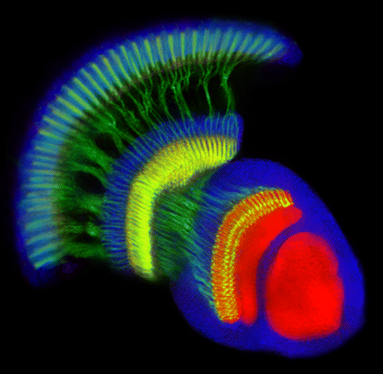
eye
lamina
medulla
Lobula complex
Image from Williamson et al., 2010
Central brain
Notes:
2

Slide 3
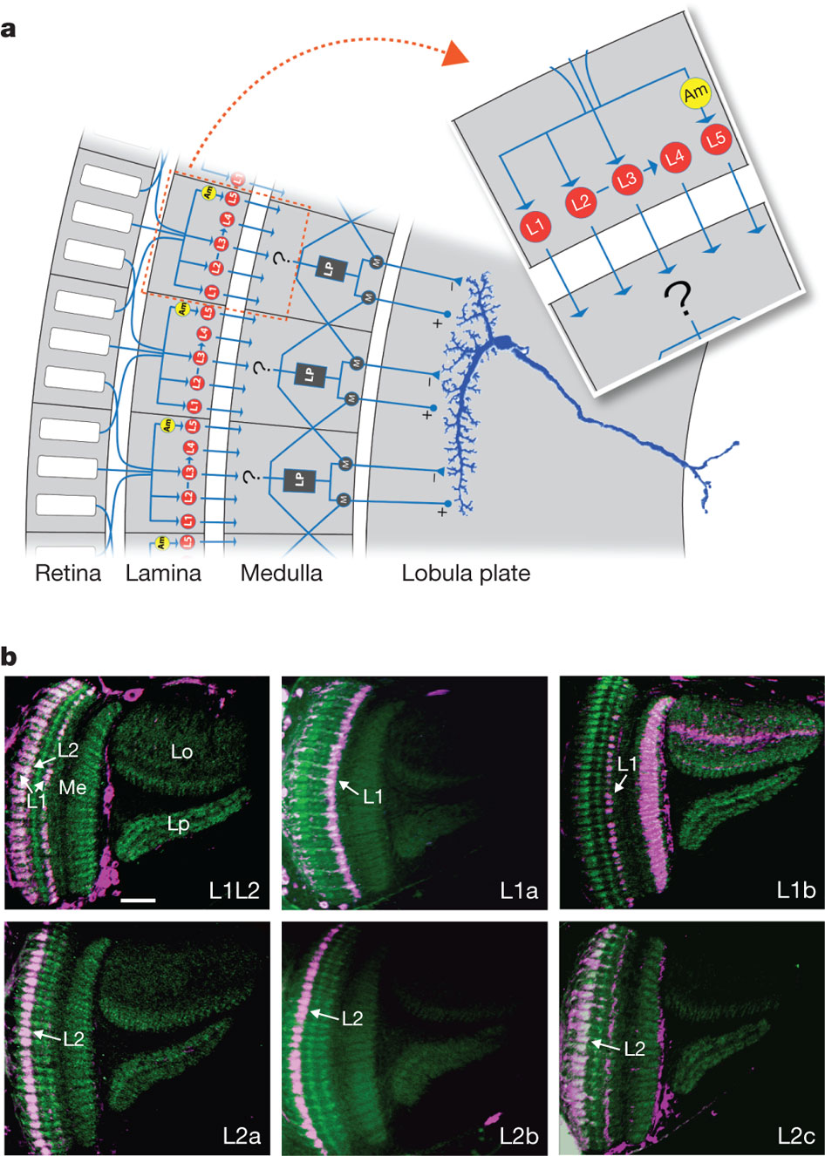

Slide 7
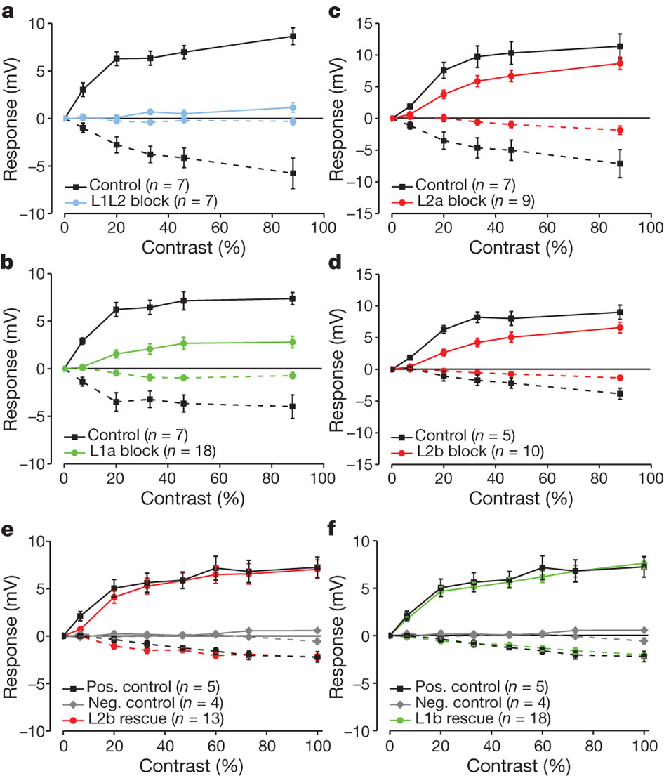

Slide 8
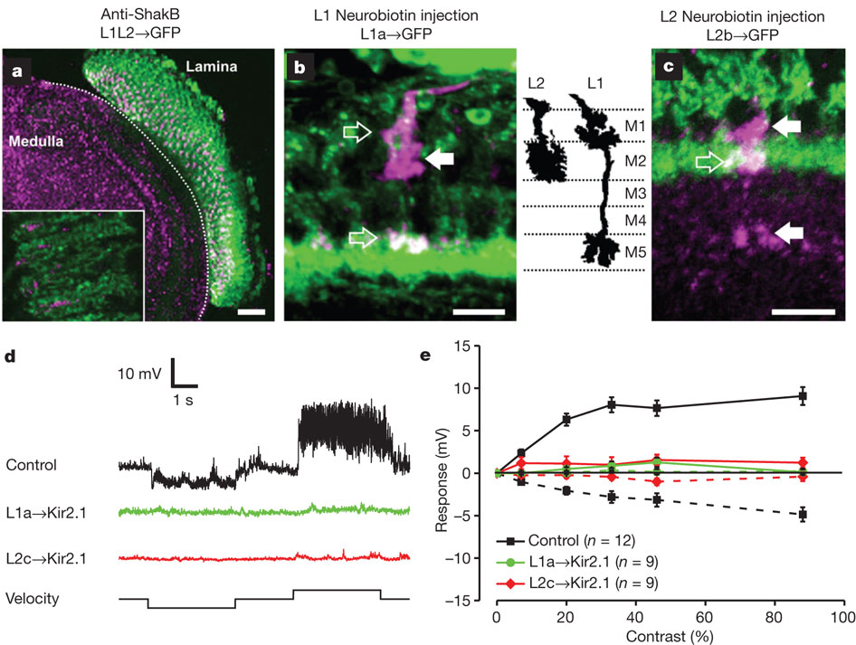

Slide 9
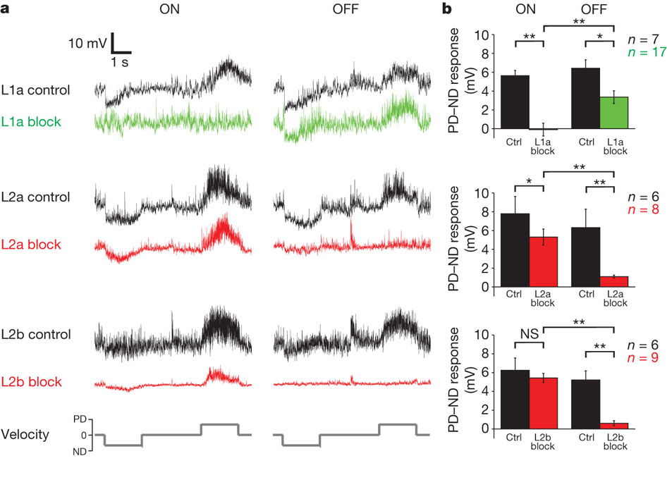

Slide 10
Processing properties of ON and OFF pathways for Drosophila motion detection
Rudy Behnia, Damon A. Clark, Adam G. Carter, Thomas R. Clandinin & Claude Desplan
Nature 512, 427–430 (28 August 2014)

Slide 11
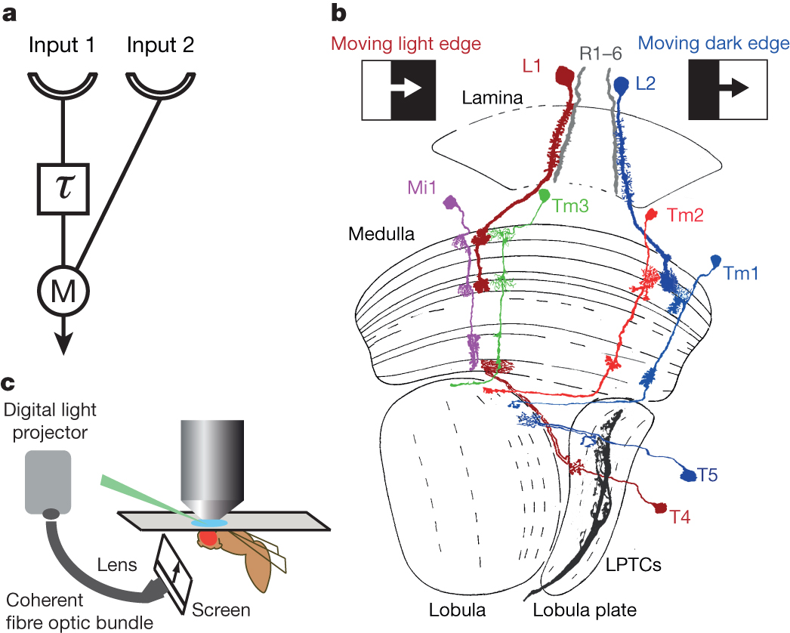

Slide 12
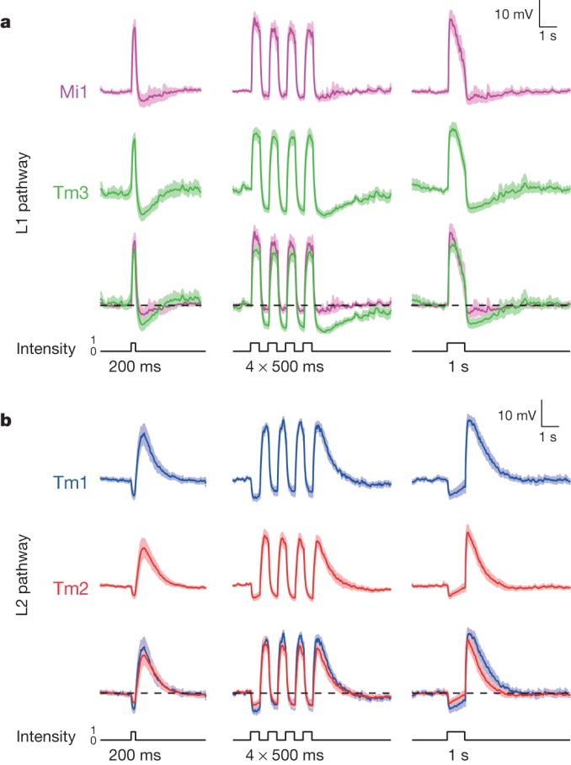

Slide 13
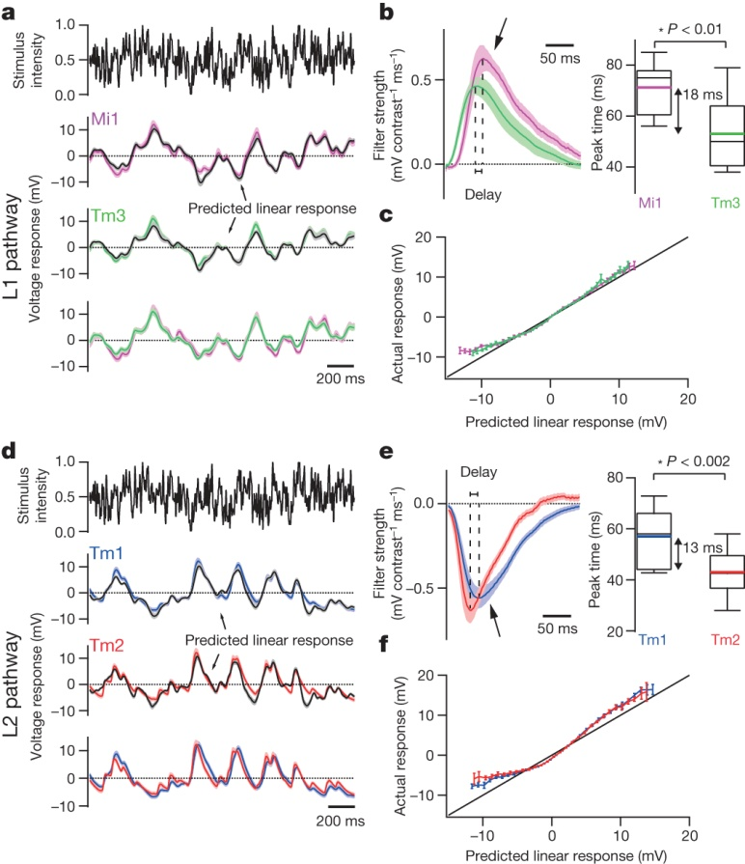

Slide 14
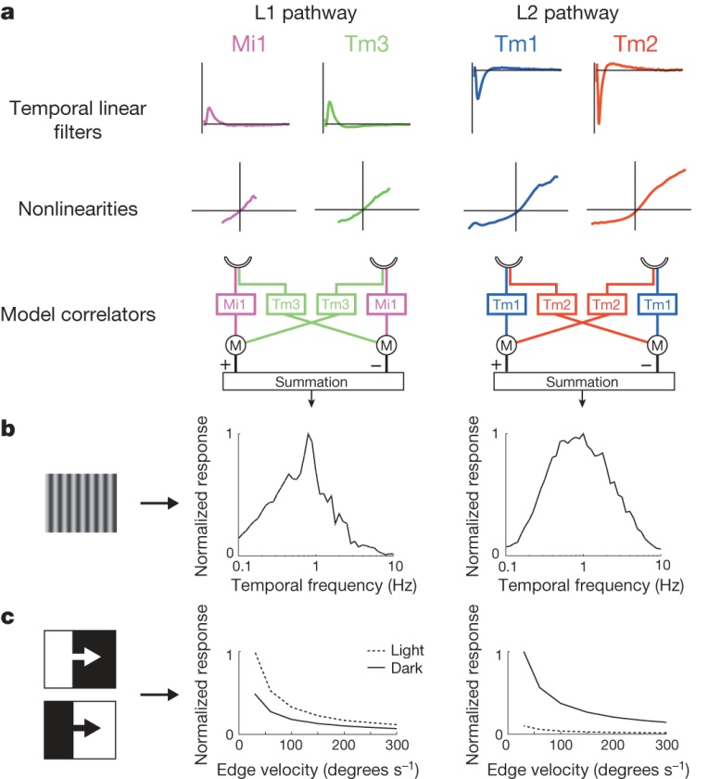

Slide 15
A directional tuning map of Drosophila elementary motion detectors
Matthew S. Maisak, Juergen Haag, Georg Ammer, Etienne Serbe, Matthias Meier, Aljoscha Leonhardt, Tabea Schilling, Armin Bahl, erald M. Rubin, Aljoscha Nern, Barry J. Dickson, Dierk F. Reiff, Elisabeth Hopp & Alexander Borst
Nature 500, 212–216 (08 August 2013) doi:10.1038/nature12320

Slide 16
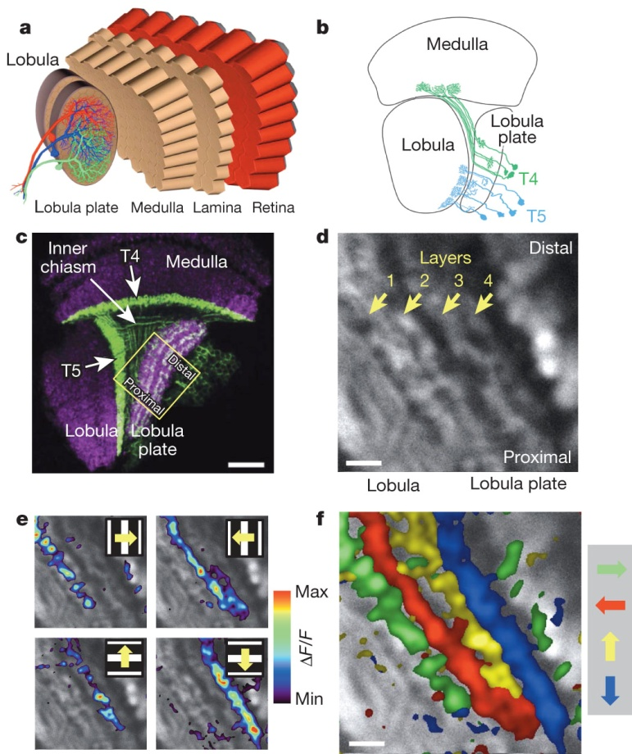

Slide 17
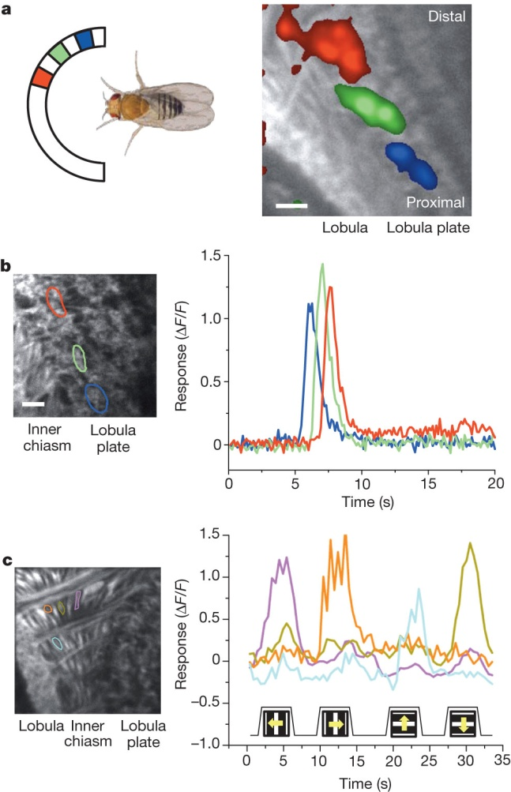

Slide 18
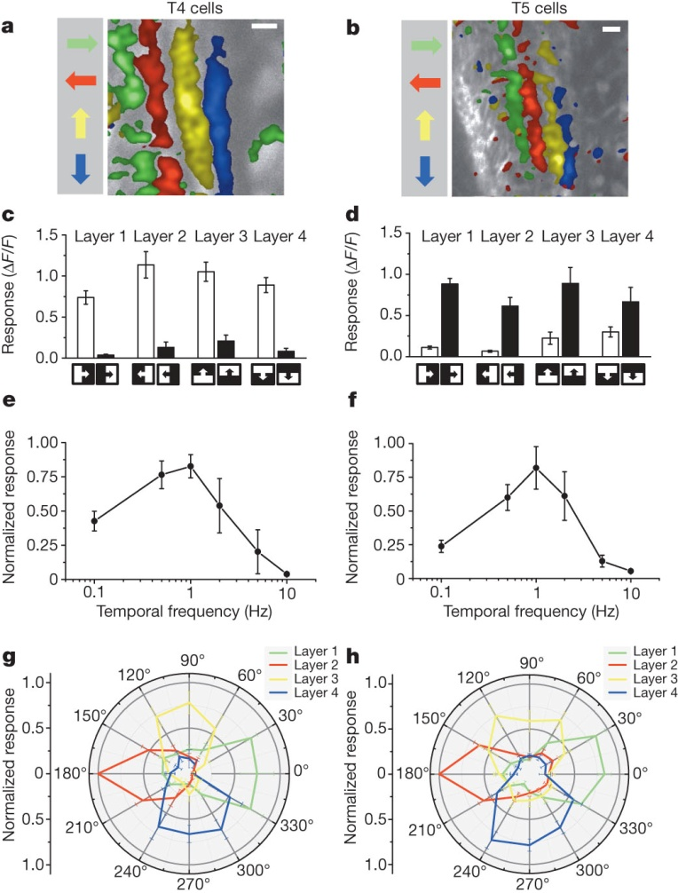

Slide 19
